Slide 1


Real Time system Lab
BITS Pilani
Pilani|Dubai|Goa|Hyderabad
Dr Suresh C
Assistant Professor

Slide 2

Real Time System
Course Description:
Fundamentals of real time systems- Typical real time systems, Hard and soft real time systems; A reference model of real time systems- processors and resources, periodic task model, precedence constraints; commonly used approaches to real time scheduling- clock driven approach, priority driven approach- various scheduling algorithms; resource and resource access control; hardware considerations in real time systems; Multiprocessing and distributed real time systems; Real time operating systems.

Slide 3
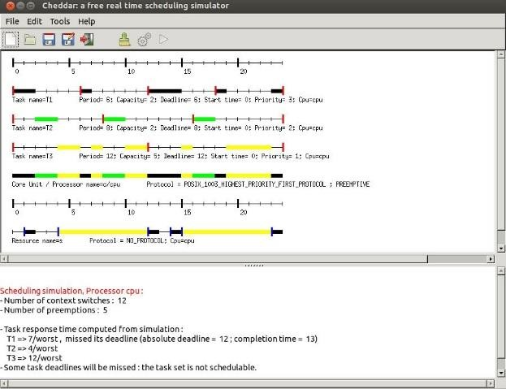
Software Used In Real Time System: Cheddar Simulation

Slide 4
Courses: Introduction to Real time system A Reference Model of Real-Time Systems Scheduling Algorithms–An Introduction, commonly used Scheduling Algorithms Commonly Used Approaches to Real-Time Scheduling Clock Driven Scheduling Priority-Driven Scheduling of Periodic Tasks

Slide 5
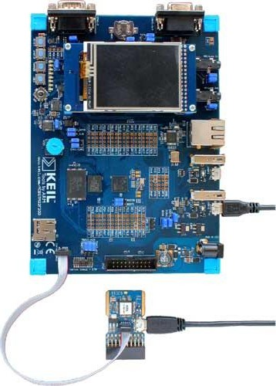
HARDWARE MICROCONTROLLER USED
STM32 ARM CORTEX MICROCONTROLLER

Slide 6
List Of experiments:
Introduction to Cheddar Simulation Environment/ Building a new project
Implementing LST/RM/DM algorithms
Implementing user defined scheduling algorithms
Implementation of PIP and PCP protocol
Introduction to RTOS on STM32

Slide 7
Learning outcomes:
Ability to Design and Analyze Scheduling Algorithms for Single Processor Embedded Real Time Systems
Ability to design , build Real Time Embedded Systems
Knowledge about both theoretical and practical aspects of Real Time Operating Systems (RTOS).

Slide 8
Cheddar
Real time operating simulator
Cheddar - open-source GNU GPL real-time scheduling simulator/analyzer
Cheddar tutorials link
http://beru.univ-brest.fr/cheddar/
http://beru.univ-brest.fr/cheddar/contribs/educational/ubo/ETR-2015-2017-2021/tp-gb.html

Slide 9
What is Cheddar?
Cheddar is a GNU GPL real-time scheduling simulator/schedulability tool. Cheddar allows you to model software architectures of real-time systems and to check their schedulability or other performance criteria.
As many schedulability analysis tools, schedulability can be assessed by scheduling simulations or feasibility tests.

Slide 10
With Cheddar, the modeling of the system to verify can be made with either AADL or with its own internal architecture design language, aka CheddarADL. Some experiments also exist with MARTE UML and other ADL languages such as PPOOA or MOSART. Finally, Cheddar hosts a domain specific language inside its scheduling simulator that allows users to design new task models or scheduling policies.
To summarize, Cheddar can help you: to perform schedulability analysis during early verifications at design time, to teach scheduling analysis or to quickly prototype new real-time scheduling policies or task models.

Slide 11
HistoryCheddar is developed and maintained by a team composed of the Lab-STICC laboratory UMR CNRS 6285, from the University of Brest and Ellidiss Technologies.
The Cheddar project was started in 2002 by Frank Singhoff, University of Brest. The full list of the contributors can be reach there. Since 2008, Ellidiss Technologies also contributes to the development of Cheddar and provides industrial support of it by their commertial tool called AADLInspector .

Slide 12
Main features
cheddar is composed of two independent parts: an editor to model the real-time system to be analyzed, and a framework to perform analysis.
The editor allows you to describe systems composed of cores, processors, cache units, network-on-chips which own software components (e.g. tasks, shared resources, buffers). Cheddar includes its own ADL, namely Cheddar ADL for such modeling work. However, Cheddar is also able to handle fully compliant AADL V2 models with Ellidiss AADL V2 parser to their commercial product AADLInspector.

Slide 13
Scheduling simulationsWith preemptive and non preemptive scheduling policies
With uniprocessor, Multiprocessor and hierarchical scheduling policies
With usual uniprocessor: RM, DM, LLF, EDF, POSIX queue policies (SCHED_RR/FIFO/OTHER), EDH, MUF, Round-Robin, D-over, time sharing policies
DAG models: HLFET

Slide 14
With L1 instruction cache entities
With different type of tasks: aperiodic, periodic, task activated with a poisson process, sporadic, Multiframe, ramdomly activated, periodic inner periodic, sporadic inner sporadic.
With shared resources (and with FIFO, PCP, PIP, IPCP synchronization protocols)
With task jitters and offsets
With various task precedencies models
With energy models : DVFS, EDH

Slide 15
Extract information from scheduling simulation, such as
Worst/best/average task response times, task missed deadlines
Number of preemption, number of context switch
Worst/best/average shared resource blocking time
Deadlock and priority inversion
Worst/average buffer utilization factor, message worst/average waiting time

Slide 16
Apply feasibility tests on tasks and buffers
Compute worst case task response time on periodic task set
Several methods to compute worst case response time with linear and tree transactions: Tindell, Palencia, ...
Apply processor utilization feasibility tests.
Compute bound on buffer size (when buffers are shared by periodic tasks)
Worst case shared resource blocking time
Memory footprint of software entities
Apply feasibility tests based on demand function.

Slide 17
Partitionning tools for periodic task set
Provide classical policies such as: Best fit, General Task fit, Fist fit, Small fit and Next fit.
Implementation of the PAES meta-heuristic to allow Cheddar users to compute Pareto Front. Such a Meta-Heuristic has been used to 1) compute partitionning of MILS architecture with objective functions to minimize missed deadlines and maximize security properties 2) assign a set of functions to a set of tasks with objective functions to minimize the number of preemptions and minimiz missed deadlines.

Slide 18
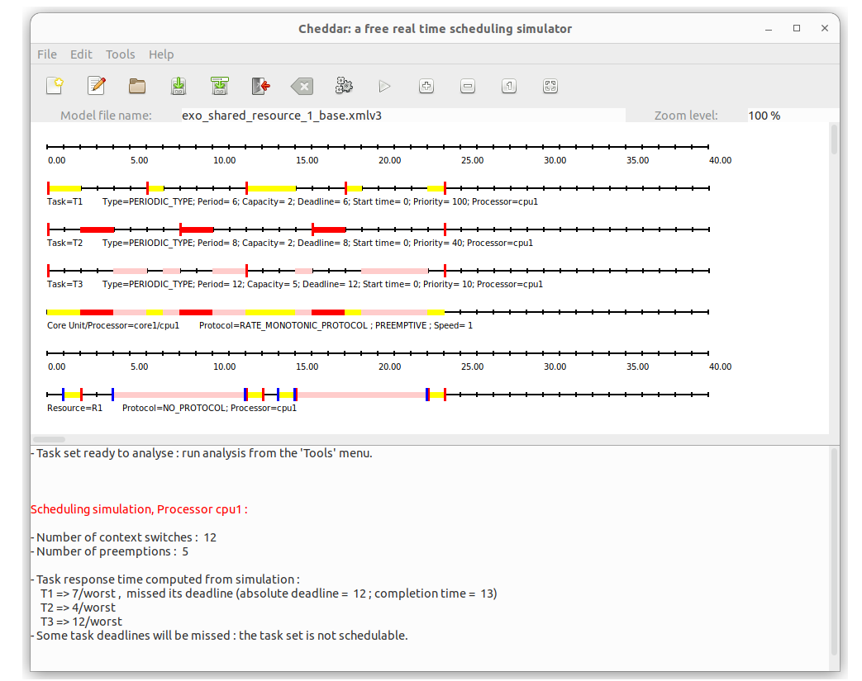

Slide 19
Thank you
12

